Slide 1
CEREALS & PULSES

Slide 2
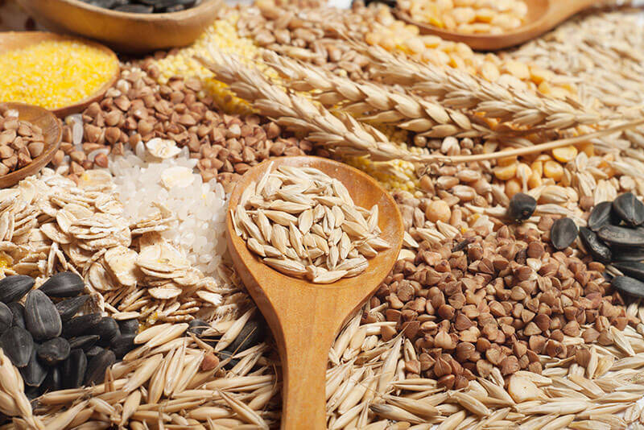
Cereals
They are cultivated for seeds which provide a staple food for humans Different cereals are better grown in different regions of the globe Wheat & Barley in temperate regions of Europe & Asia Rye & oats in Northern & Eastern Europe
Rice in wetter warm temperate & subtropical part

Slide 3
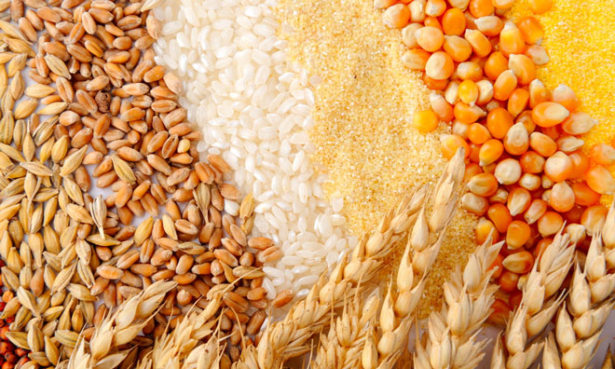
Importance of Cereals
The are pleasant to eat & have no dominant or unpleasant flavor. They are best energy food It could be easily be prepared into wide variety of products- flour, biscuits, pasta, noodles & breakfast cereals They are inexpensive as compared with foods of animal origin Ripened grains could be easily preserved & transported

Slide 4
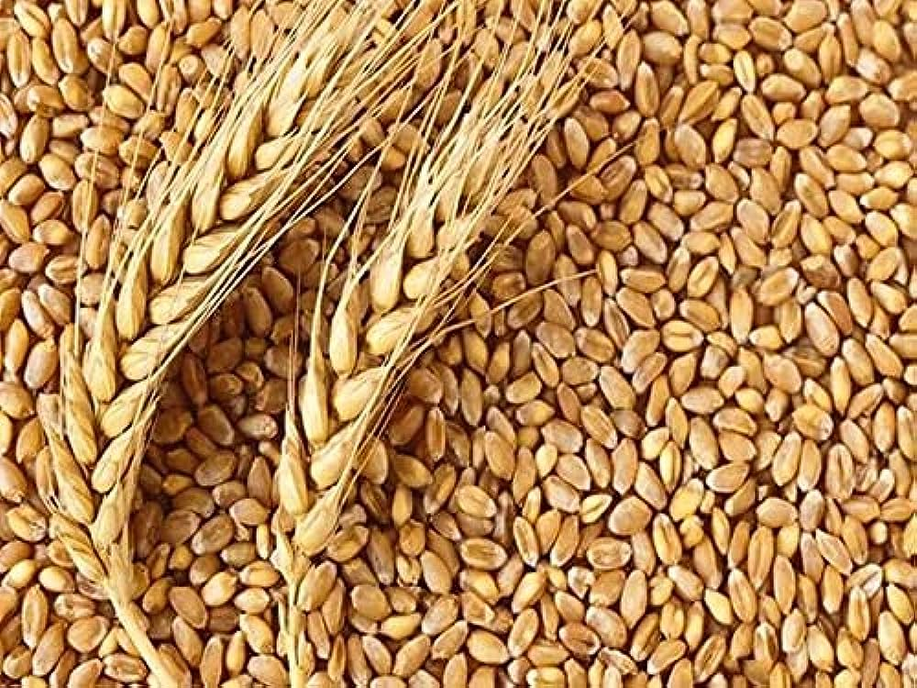
Wheat
It is grown for milling into flour
Characteristic of flour depends upon how wheat is grown & climate
Types of flour
Soft flour-Cakes, biscuits except puff & flaky pastry Strong flour – bread, puff and flaky pastry Whole meal flour – whole meal bread & roll
Hard wheat contains around 11-18 percent protein
Soft wheat contains around 8 to 11 percent protein
Durum wheat containing 14-18 percent protein is used for making pastas

Slide 5
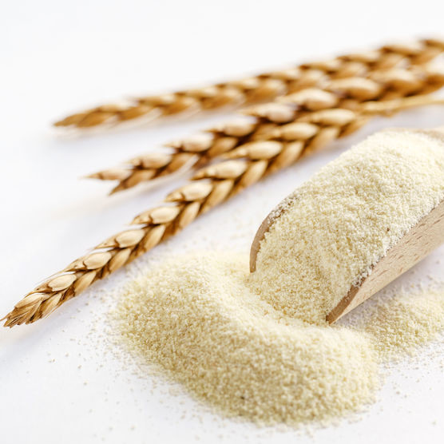
Semolina
Crushed (not rolled) endosperm of wheat
Used for preparing Gnocchi, for thickening soups, in preparation of pasta & in milk puddings

Slide 6
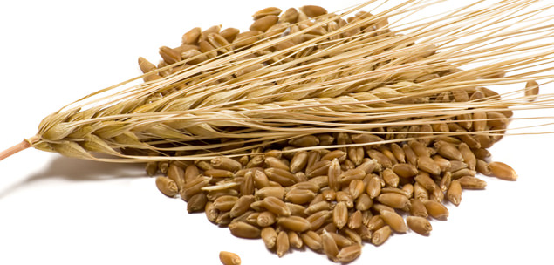
Barley
Barley is rich in starch and sugar, and low in fat and protein The grain has rich nut like flavour & has an appealing chewy pasta consistency The whole grain of barley is known as pot or Scotch barley & requires soaking overnight Barley when roasted changes into malt & is used in brewing & distilling of vinegar

Slide 7
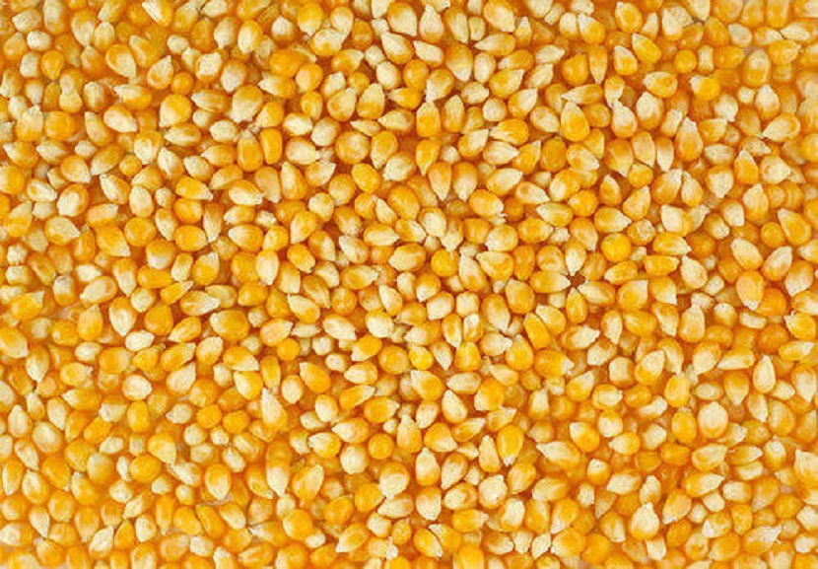
Maize
It is also known as corn, sweet corn or corn on cob Young & tender maize is eaten as a vegetable (sweet corn) Whole corn is processed as breakfast cereal Fully ripened maize is ground into flour used as thickening agent (corn flour)
It also yields oil suitable for cooking

Slide 8
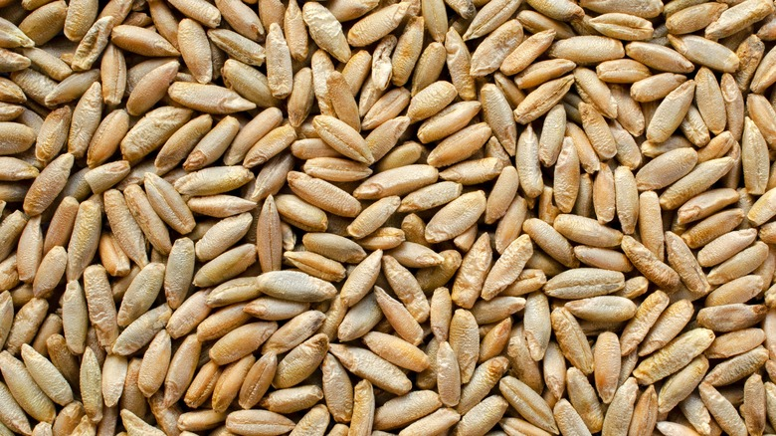
Rye
It is only cereal other than wheat containing gluten The dough produced from rye flour sticky dense consistency and the baked product has a low volume
The bread is dark in colour & close in texture

Slide 9
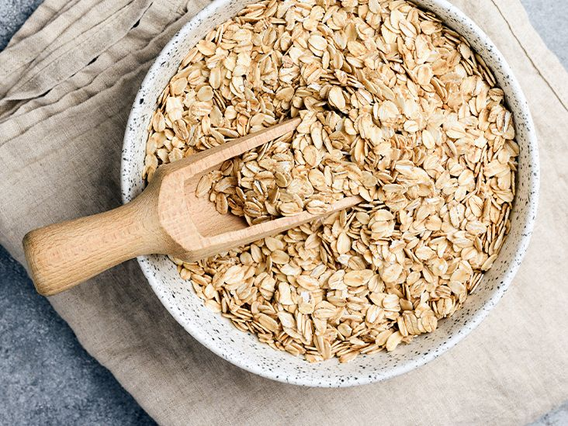
Oats
Have a high protein and fat content but no gluten for which it is unsuitable for bread making Highest food value of any of the cereals Used for making biscuits, cakes & porridge Oat meal is used for preparing ginger bread & oat cakes Oat flakes are mainly used for making porridge

Slide 10
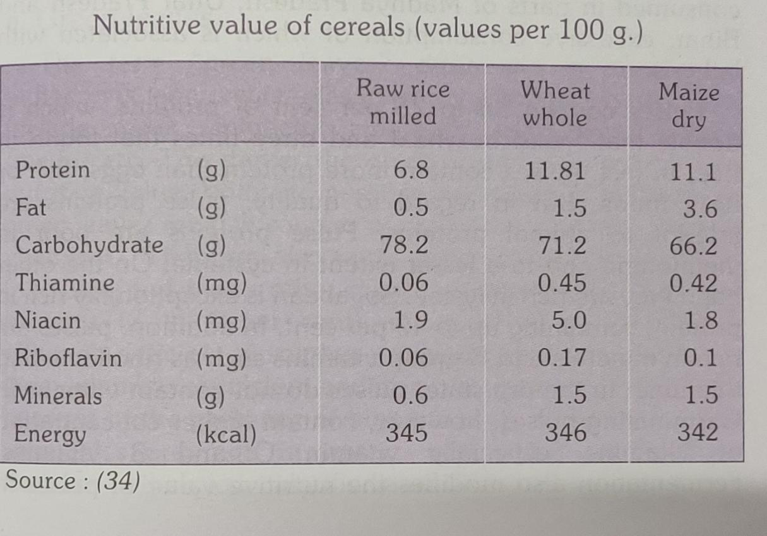

Slide 11
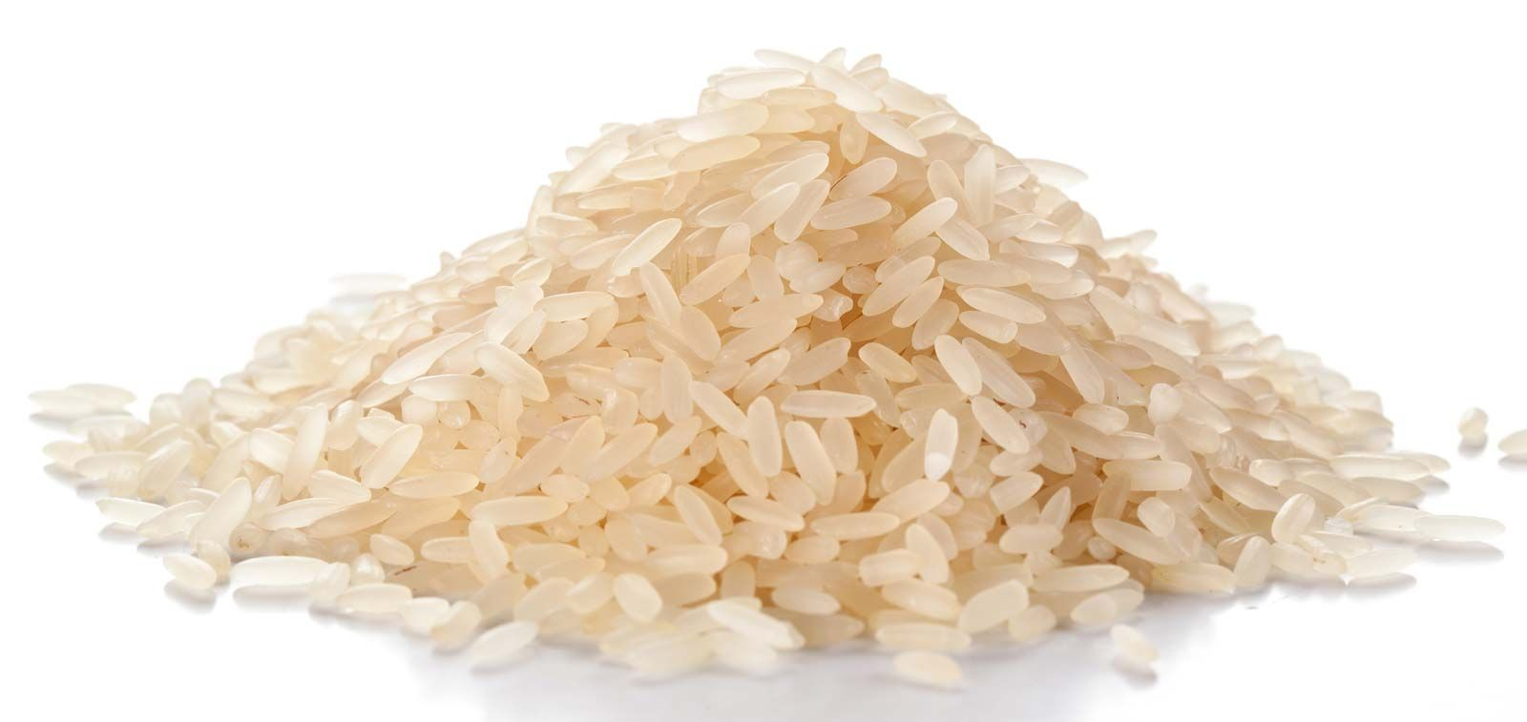
Rice
It is least nutritious of all cereals, containing more starch & less protein, fat, and minerals
Rice is eaten white after removal of bran & germ
Types
Long grain- narrow pointed grain for plain boiled rice Medium Grain –all purpose rice suitable for sweet & savoury dishes Short grain- a short round grain best suited for milk puddings Brown rice –Whole grain of rice with only the outer husk removed

Slide 12
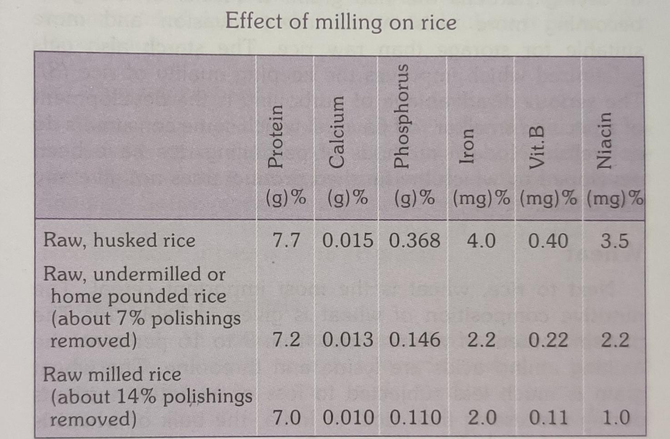

Slide 13
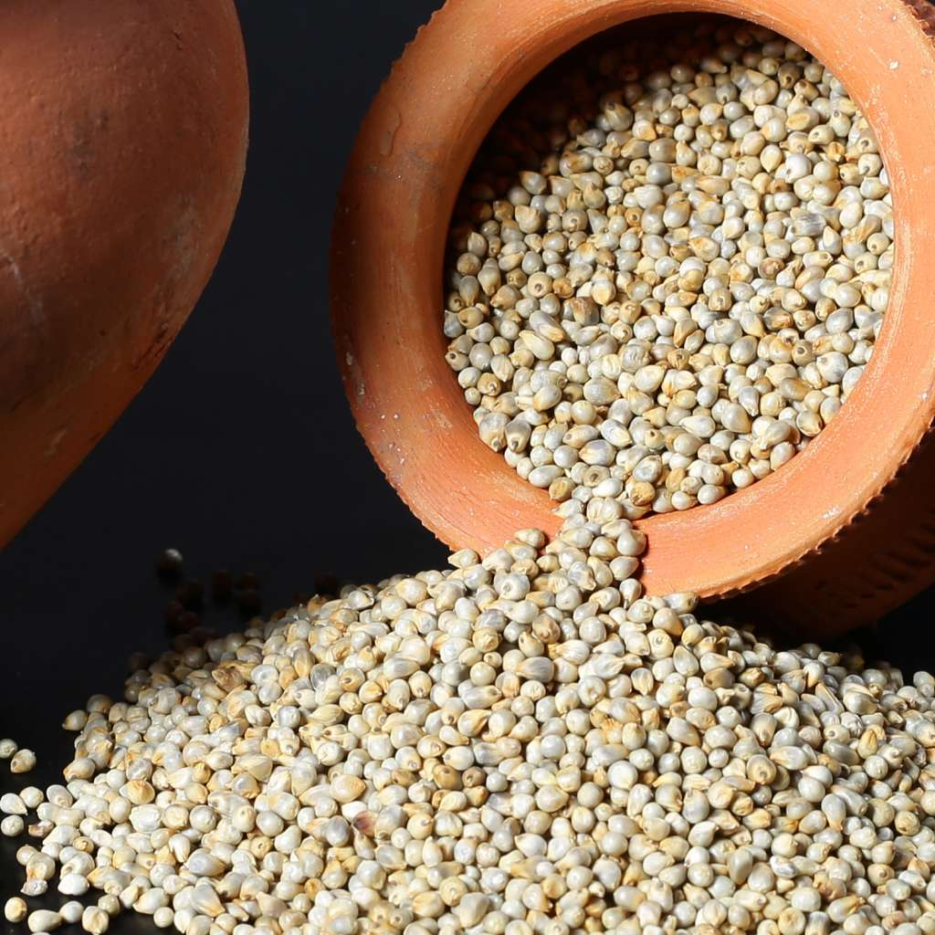
Millet
It is highly nutritious, non glutinous It is mildly sweet, nut like flavour and contains approx 15% protein It contains a high amount of fiber & minerals Used to make flat bread & griddle cakes

Slide 14
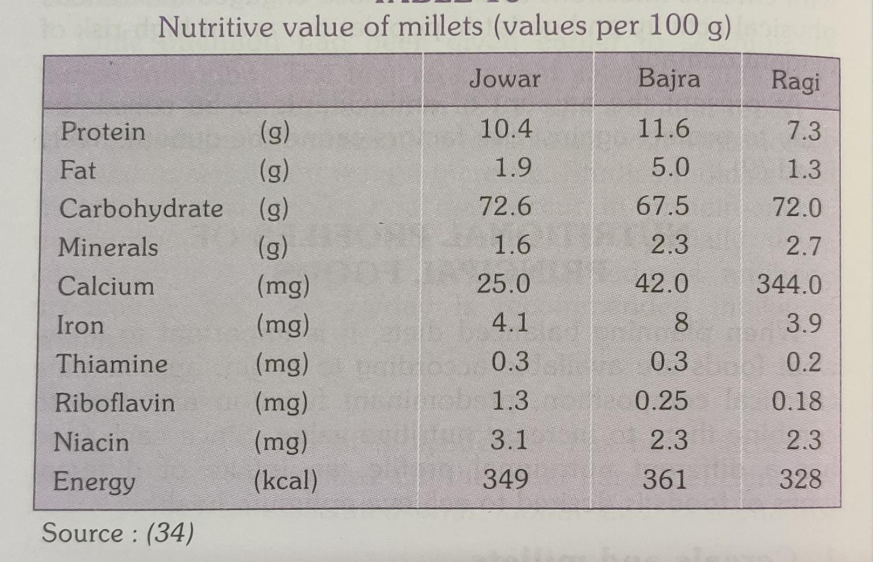

Slide 15
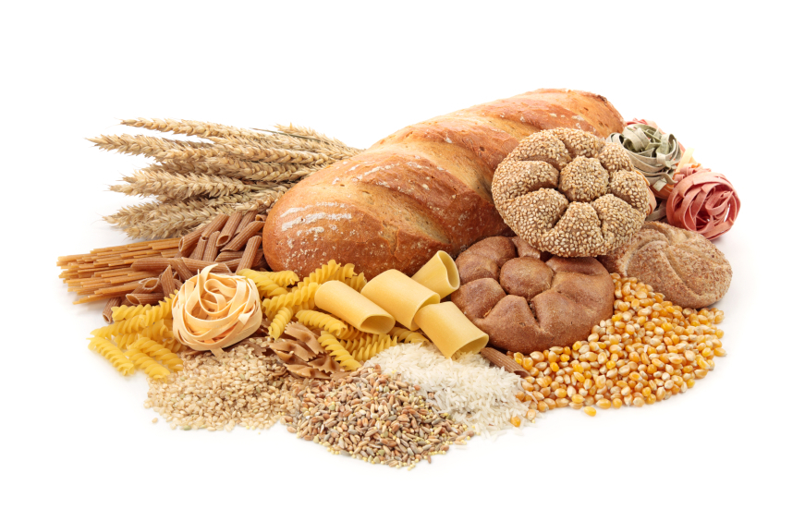
Products

Slide 16
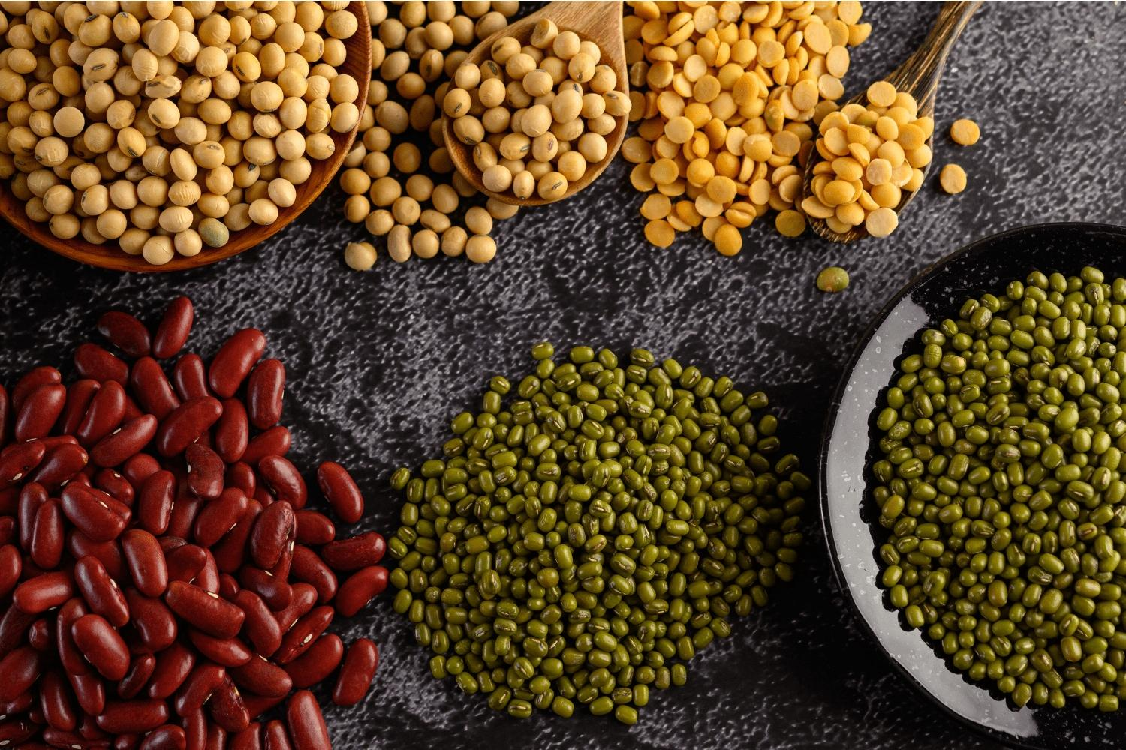
Pulses
An edible seed from plants belonging to the legume family
Pulses are defined as annual leguminous crops yielding from one to twelve grains or seeds of variable size, shape and colour within a pod

Slide 17
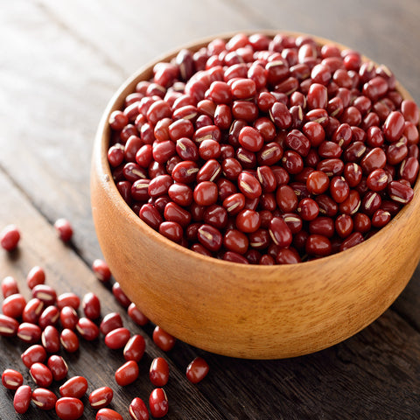
Adukhi Beans
Also known as adzuki beans, these tiny, deep red beans have a sweet, nutty flavour & are popular in Oriental dishes
Are cooked quickly & used in casseroles & bakes Ground into flour & used in cakes,bread & pastries Ex-adzuki bean miso soup

Slide 18
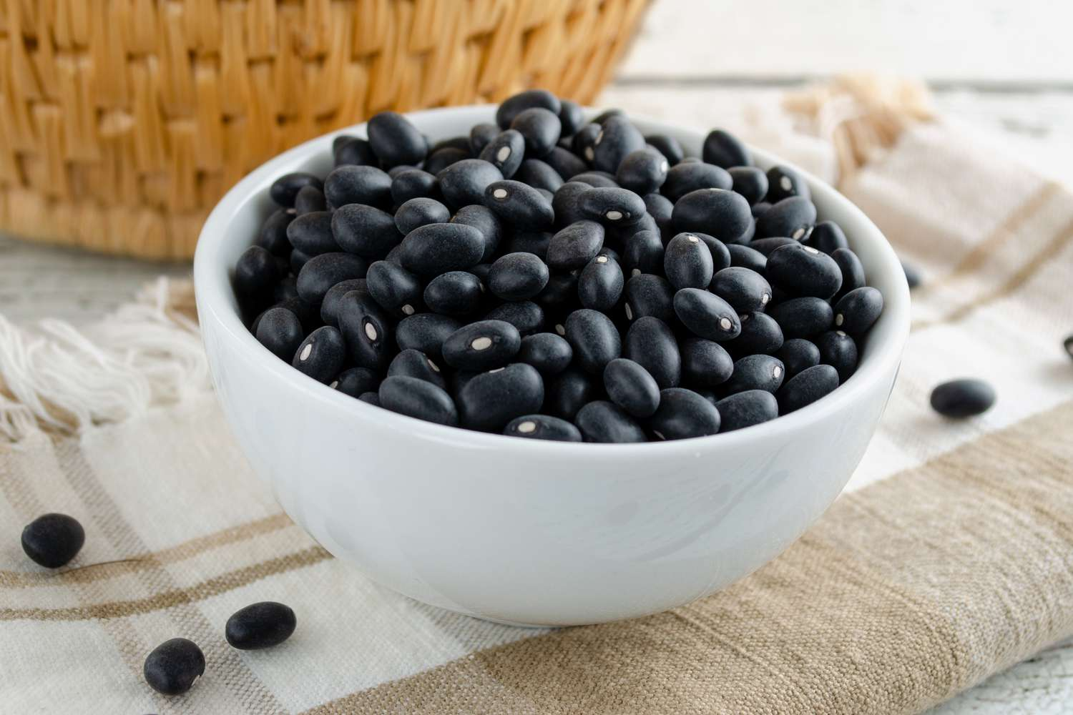
Black Beans
Shiny black, kidney –shaped, sweetish flavour Used in Caribbean dishes Used in soup preparation & bean salads

Slide 19
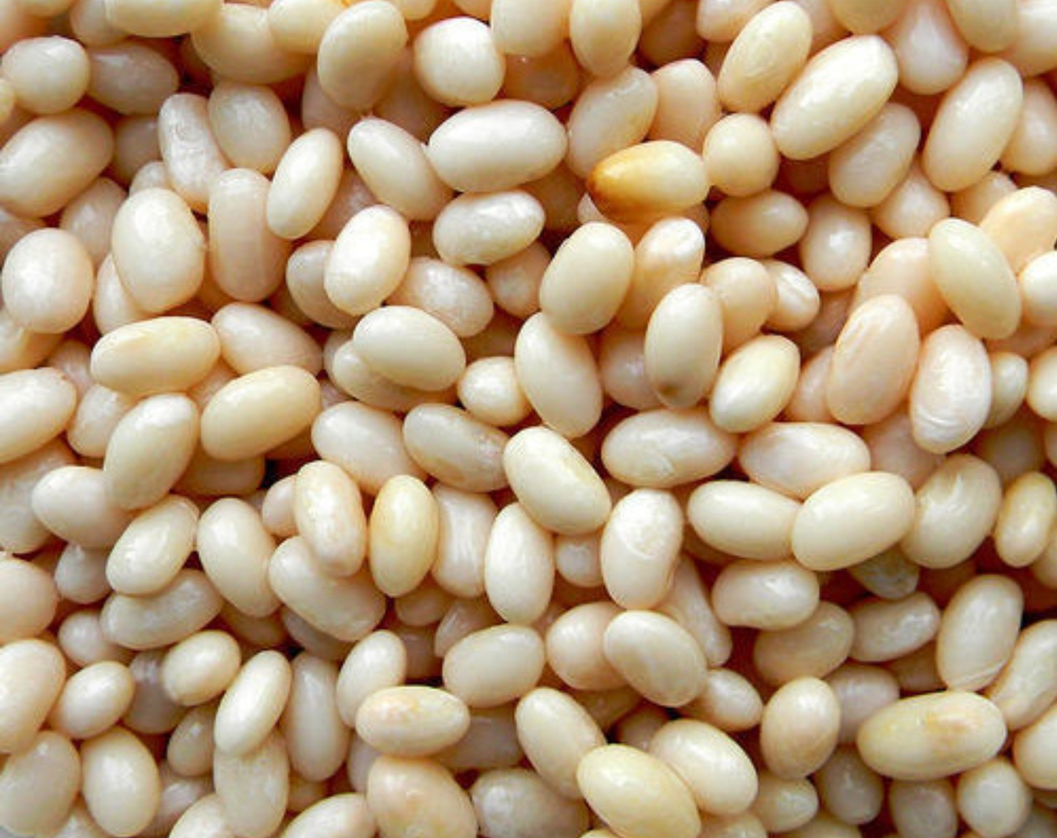
Haricot beans
The beans are roughly oval shaped and flattened, with a pure white edible skin.
The flavour of haricot beans is relatively bland, although the beans are rich in protein
Commonly used for canned baked dishes

Slide 20
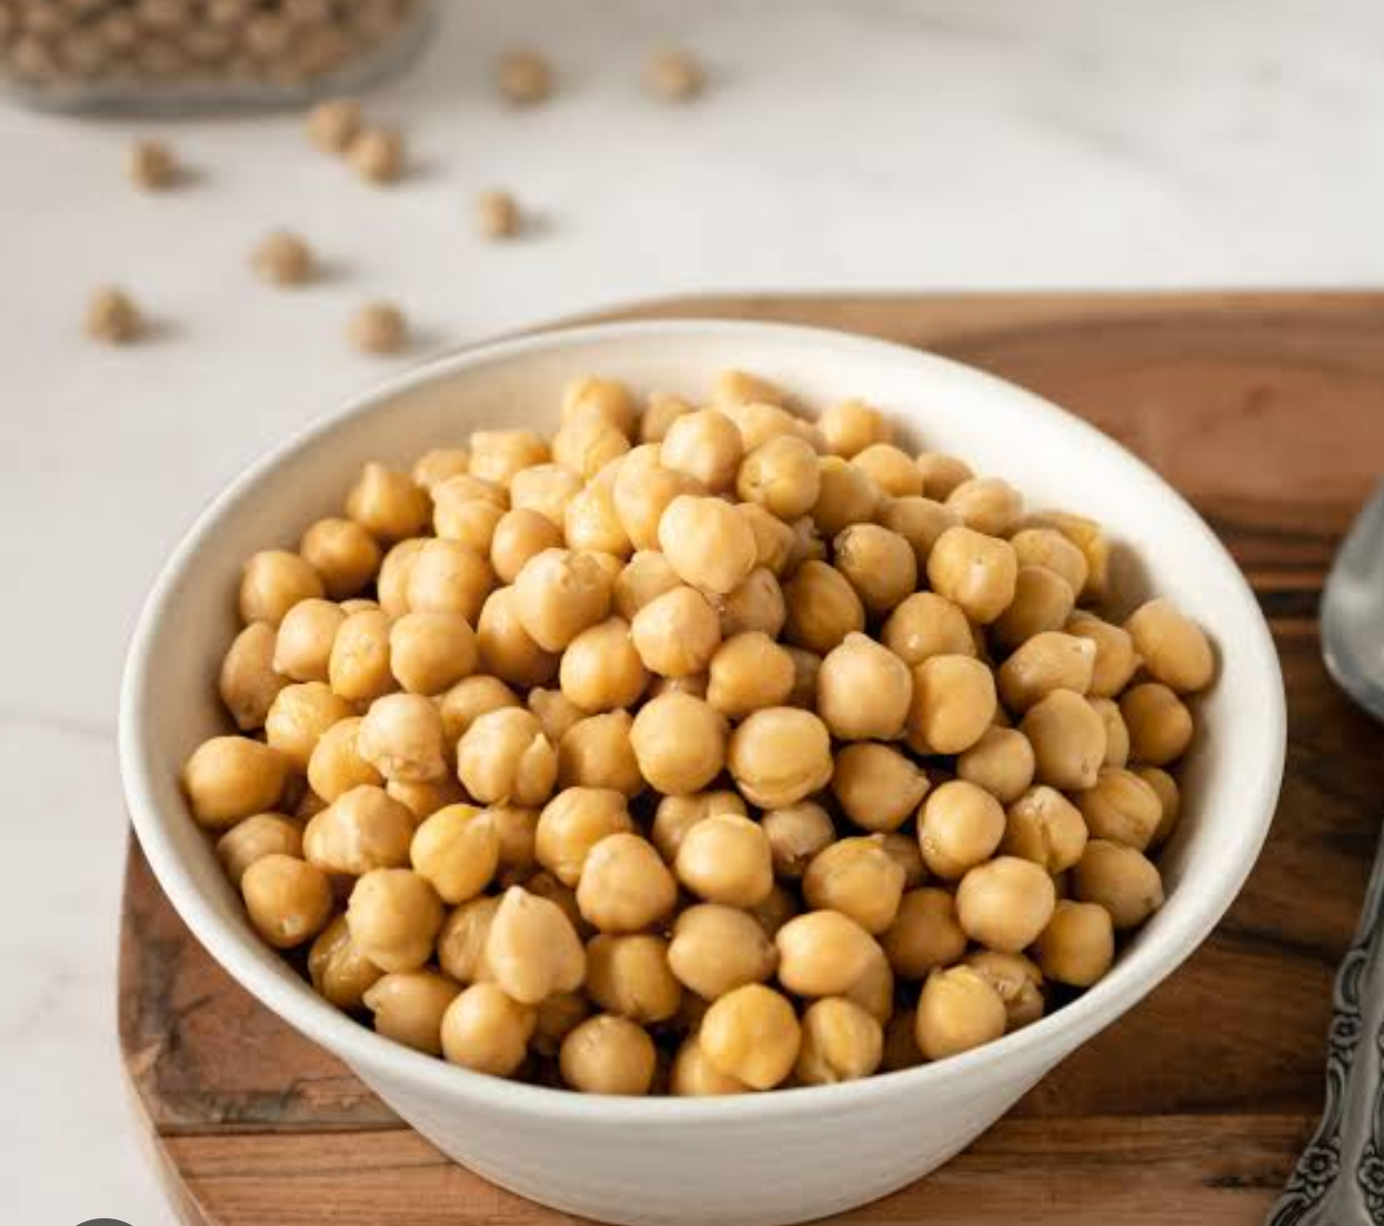
Chick peas (Bengal Gram)
Also known as garbanzo beans, robust & hearty chick- peas have a delicious nutty flavour & creamy texture
Two varieties are available
Desi, which has small, darker seeds and a rough coat Kabuli, which has lighter coloured, larger seeds and a smoother coat
They are ground into flour to make flat bread & fritters

Slide 21
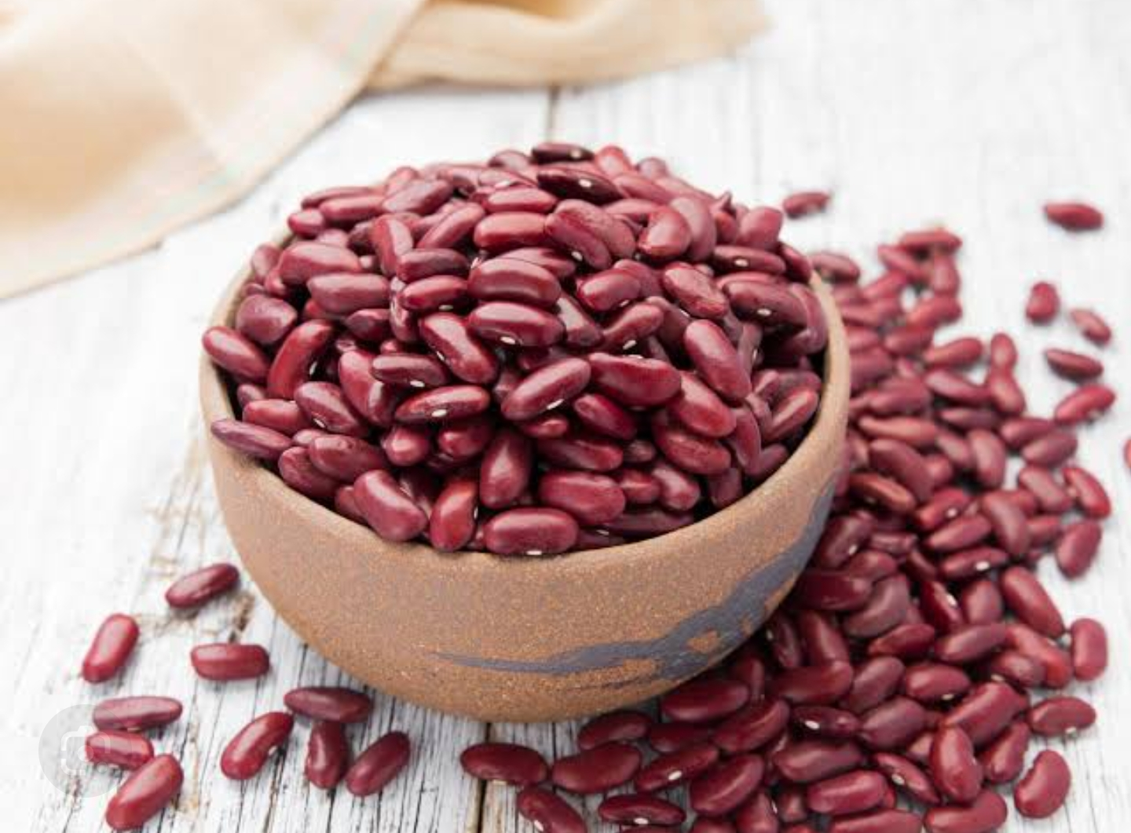
Kidney beans (Rajmah)
Glossy,mahogany –red kidney beans retain their colour and shape when cooked. Have a soft mealy texture Used in preparing various types of salad

Slide 22
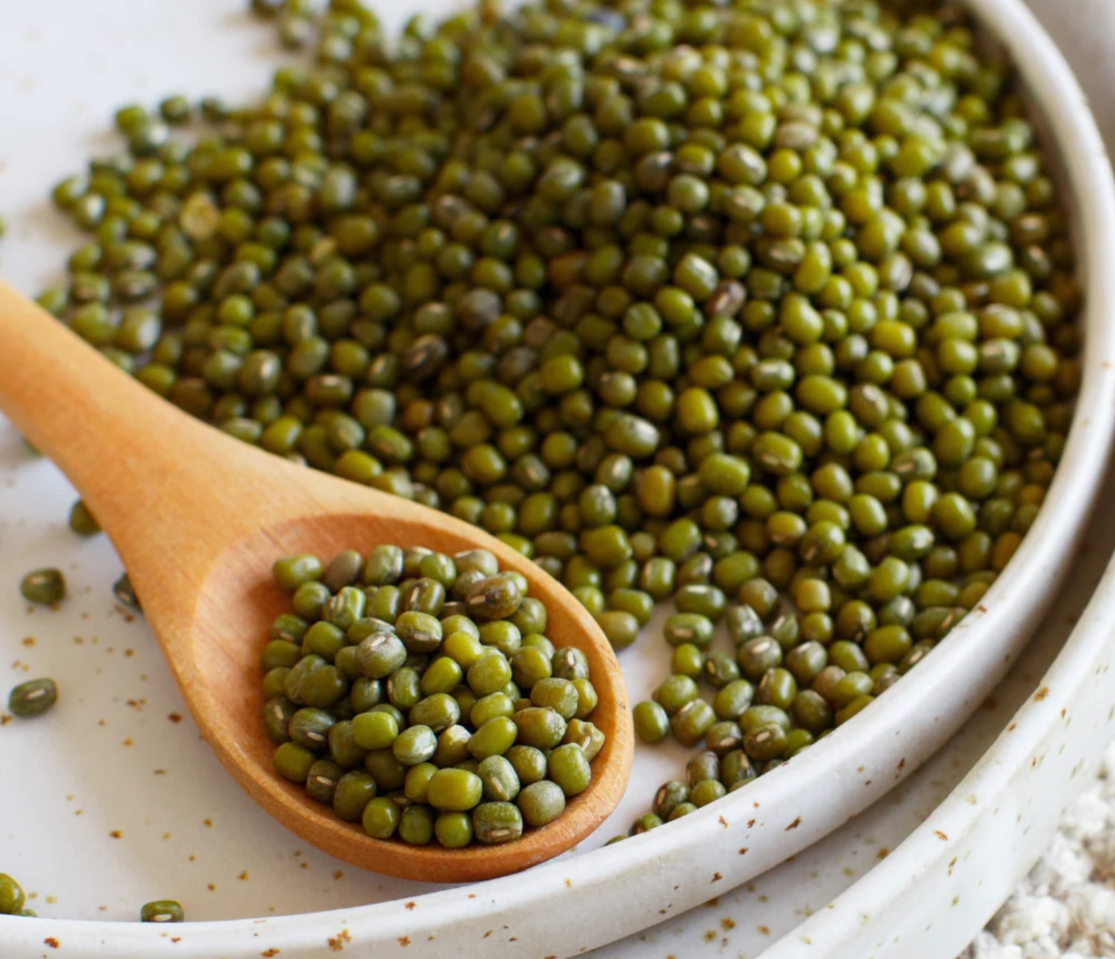
Green Gram Gram (Mung Beans)
Beans are small, olive – coloured and are native of India With their skins removed, mung beans are light yellow in color. It is soft & sweet when cooked also used as sprouted beans

Slide 23
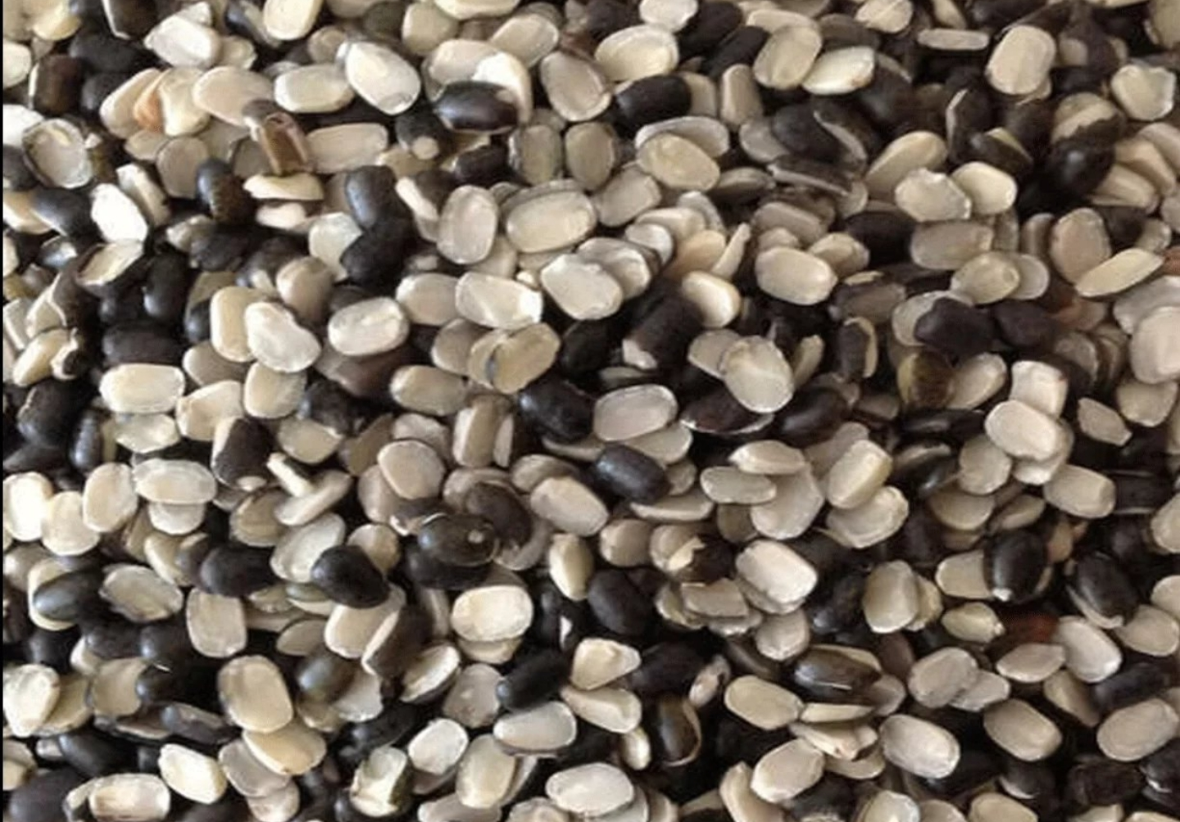
Split Black Gram (Urad Dal)
Boiled or eaten whole or after splitting into dal It is ground into flour or paste
Used in culinary preparation like dosa,idli, vada & papad

Slide 24
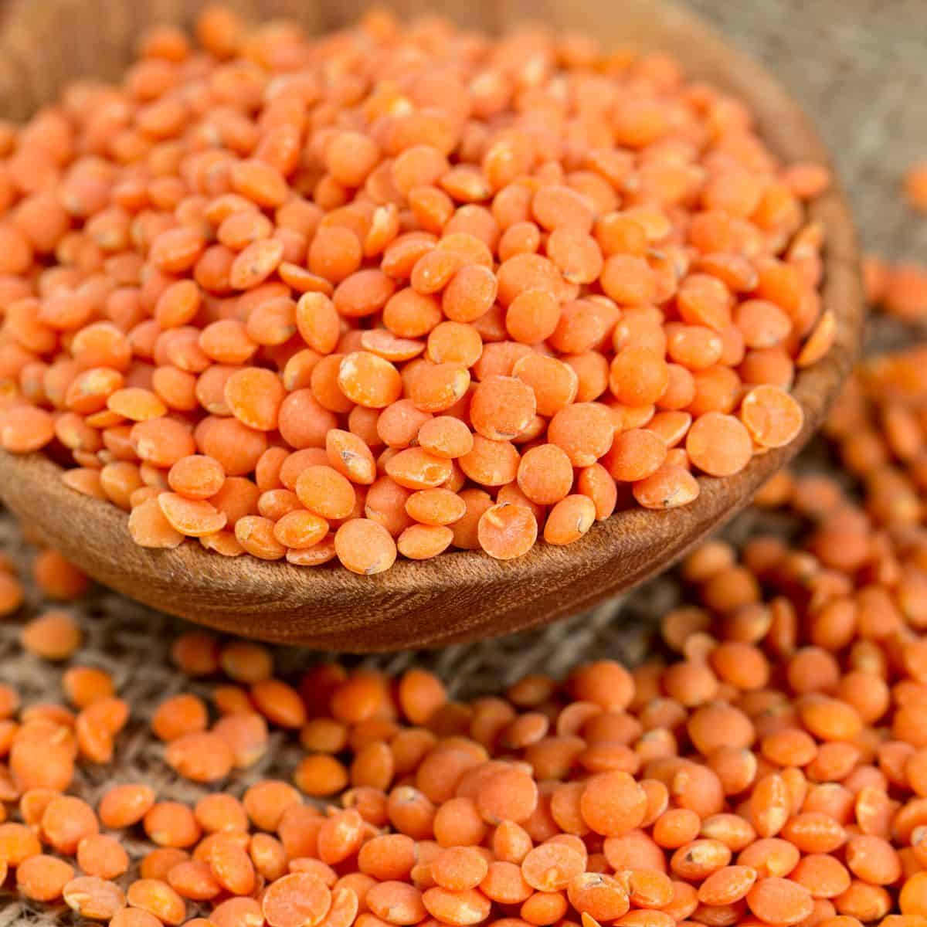
Red Lentil (Masur Dal)
Low in fat but high in protein & fiber
They have earthy flavour & they cook easily

Slide 25
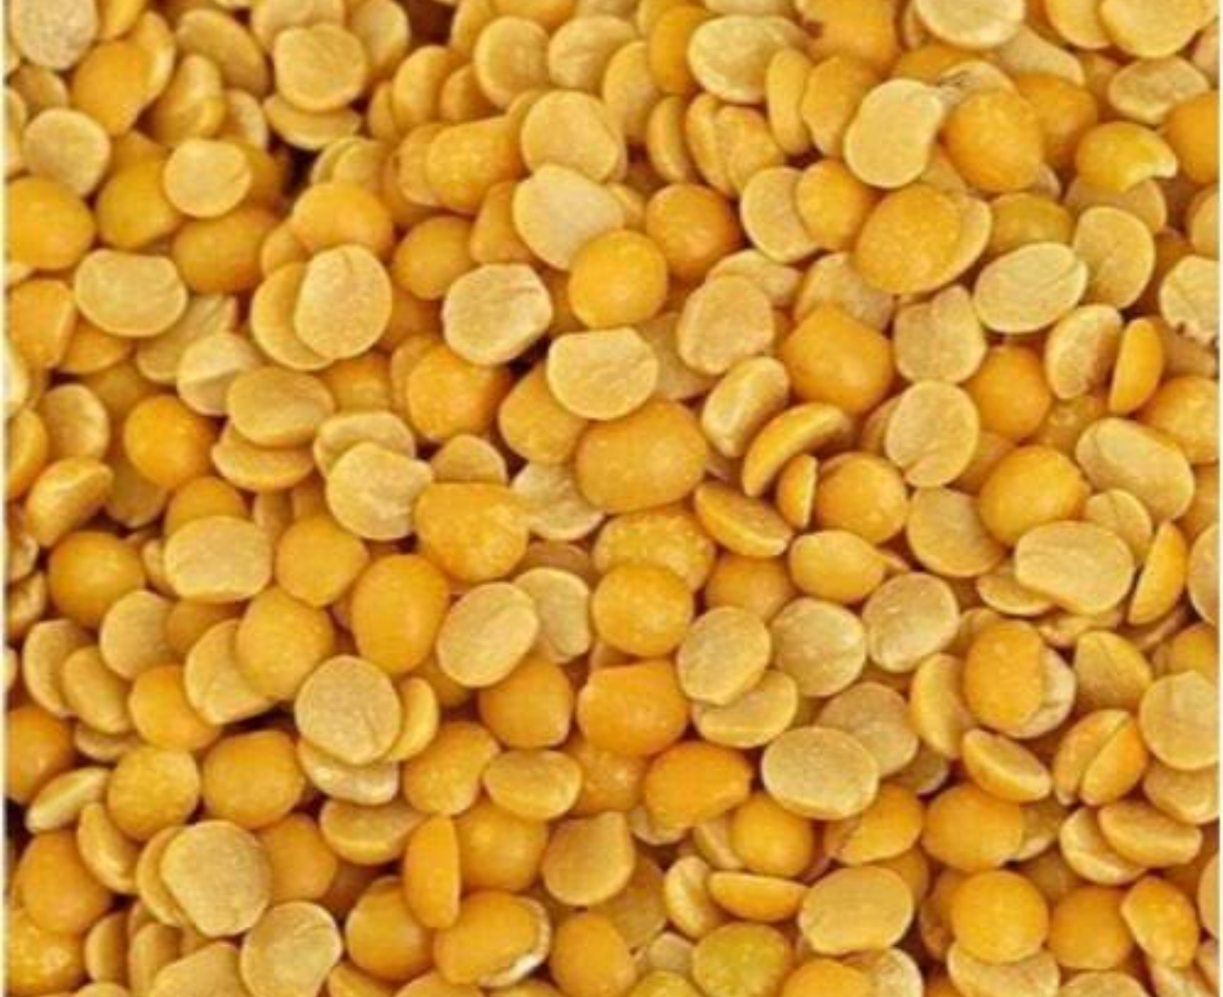
Yellow lentil (Arhar dal)
Whole tur lentils are yellow with tan jackets Usually sold skinned and split They have a nutty flavour

Slide 26
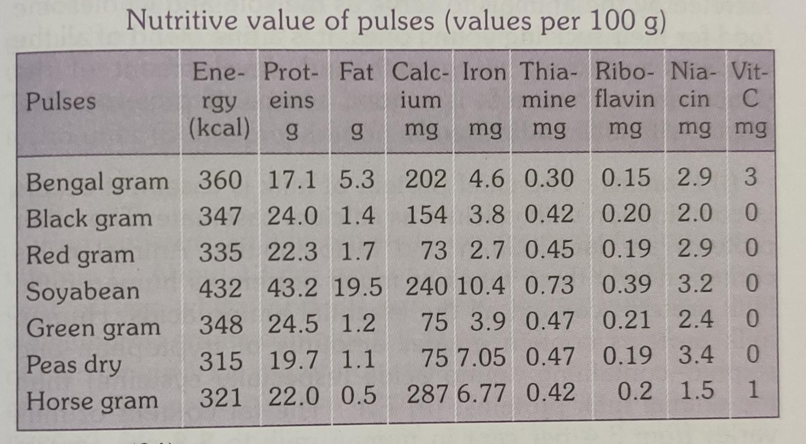

Slide 27


